Slide 1

Multi-Sensor Analysis of Aircraft Engine Health
Prepared by: Nuhad Kottampara

Slide 2
Identifying Degradation Patterns for Predictive Maintenance

Slide 3
Problem Definition
The Challenge: Aircraft engine failure poses a critical risk factor, resulting in significant financial loss, operational delays, and safety hazards.
The Opportunity: Modern engines are equipped with multiple sensors that monitor temperature, pressure, and rotational speed.
Goal: Exploratory Data Analysis (EDA) to extract meaningful health insights and identify early indicators of engine failure to support predictive maintenance.

Slide 4
Dataset Overview
Source: NASA CMAPSS Turbofan Engine degradation dataset.
Key Feature:
Engine ID and Cycle: Unique identifiers and time-series operational cycles.
Settings: 3 Engine operational settings
Sensors (s1-s21): Physical Parameters including fan inlet Temperature. HPC outlet pressure and Physical fan speed.

Slide 5
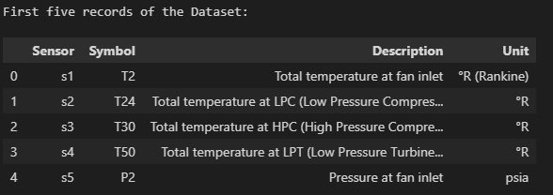
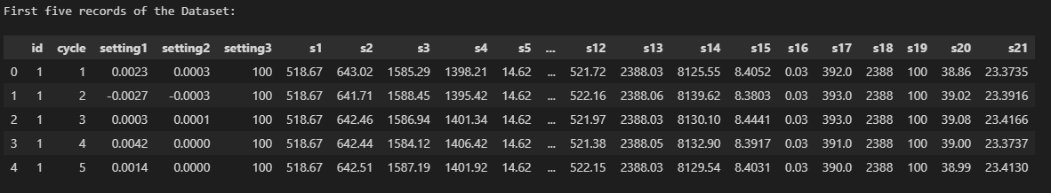
Details about the sensor.
Engine Dataset

Slide 6
Methodology and Data Preprocessing
Tools Used: Python libraries including Pandas, NumPy, Matplotlib, and Seaborn.
Data cleaning and validation.
Statistical summary of numerical parameters.
Trend visualization across operational cycles.

Slide 7
Data Cleaning
Checked the missing data
Checked duplicate rows
Correcting the data types

Slide 8
Feature Engineering
Raw sensor data is noisy and hard to interpret over many cycles.
Feature engineering = creating new, more meaningful variables from existing sensors.
Goal: highlight engine health trends and early warning signs of failure.

Slide 9
Why S4 and S11 Sensors?
s4: turbine outlet temperature – strongly related to thermal stress.
s11: pressure at high‑pressure compressor outlet – related to pressure load.
These two sensors are good candidates to track degradation over time.

Slide 10
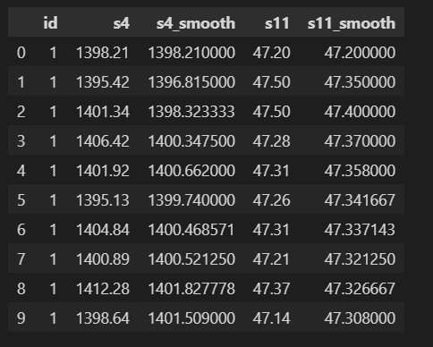
Smoothing
Creating rolling averages of s4 and s11 for each engine.
Reduces random up-and-down noise between cycles.
Makes long term trends in temperature and pressure.

Slide 11
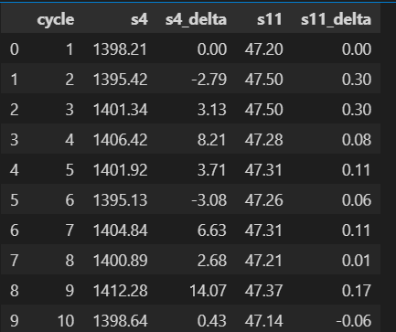
Sensor Deltas
Compute differences between current and previous cycle value.
Measures how fast the sensor is changing, not just its level.
Large positive deltas can indicate sudden stress or abnormal behaviour.
Notes:
A value of 0 means no change from baseline.
Positive values indicate pressure has increased from baseline.
Negative values indicate pressure has decreased from baseline.

Slide 12
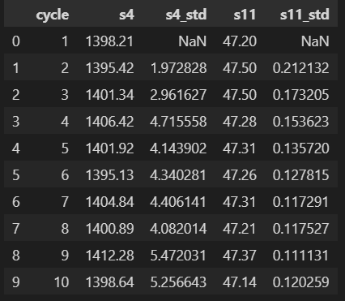
Volatility
Rolling standard deviation over a window of recent cycles.
Captures how stable or unstable the sensor is around its mean.
Increasing variability can be a sign that the engine is entering a failing phase.
Notes:
Temperature sensor (s4) is volatile and shows rising rolling standard deviation - indicates instability or mechanical stress.
Pressure sensor (s11) is stable - less sensitive to early degradation.
Increasing s4_std over time can act as an early warning signal for potential engine issues.

Slide 13
Filtering Data
Operational Filtering
Phase Filtering
Notes:
Operational Reduction – remove sensors have zero or near-zero variance ( They are constant) Phase Filtering- looking at only specific parts (phases) of an engines life, instead of using the entire lifecycle.

Slide 14
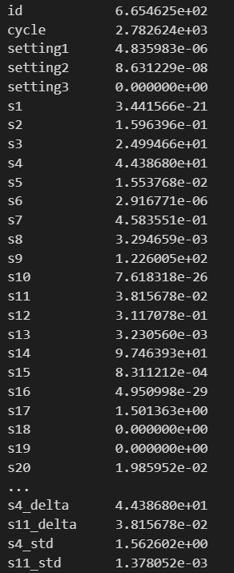
Operational Filtering
Initially, find the sensors with zero or near-zero variance.
Zero or near-zero variance sensors: ['s1', ‘s10', 's16', 's18', 's19', 'setting2', 'setting3’]
Dropped these columns.
Notes:
Sensors that do not change or change very little do not provide meaningful information about the engine's health. Including that columns adds dead weight and can confuse statistical models or visualizations.

Slide 15
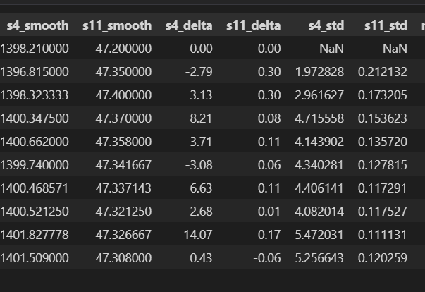
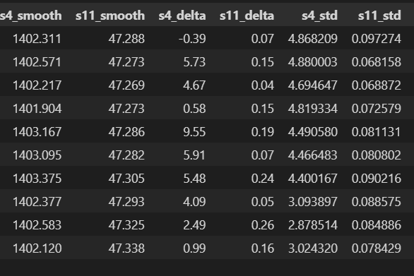
Phase Filtering
Late–Phase: last 20 cycles
Early-Phase: First 20 cycles
Healthy state
Near failure
Notes:
Looking only specific phases – not the entire lifecycle.
Early Phase:
Represents normal, healthy engine behaviour with stable sensor values, minimal drift, and low volatility.
Late-Phase:
Shows clear degradation signs – stronger drift and increased volatility. S4 is a strong indicator of engine failure

Slide 16
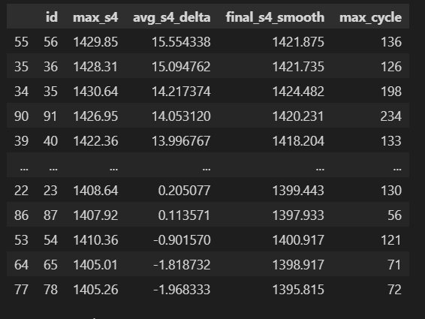
Aggregating Data
Aggregate the Data
Maximum temperature: Worst condition reached
Average delta: Long-term degradation level
Final smoothed value: condition near failure.
Rank the data by risk.
Top engine: Highest degradation.
Notes:
Top engines in this list = highest degradation
These are high-risk units
This ranking correctly separates fast degraders, slow degraders, and stable engines, enabling predictive maintenance prioritization.

Slide 17
Exploratory Data Analysis
Multivariate Analysis
Engine Life Distribution
Sensor spread
Univariate Analysis
Bivariate Analysis
Sensor trends over time
Correlation Analysis

Slide 18
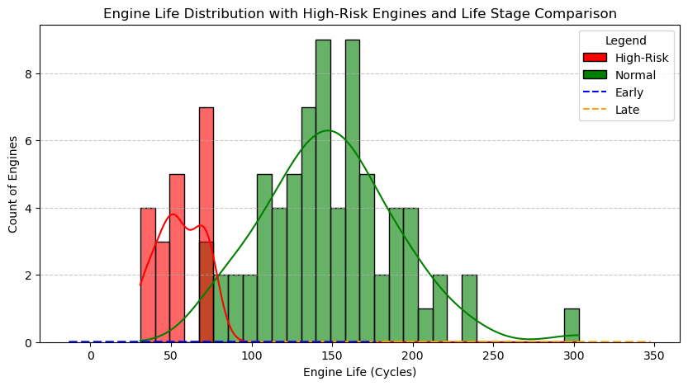
Engine Life Distribution
Notes:
Analyze the distribution of the total operational cycles (lifespan) for each engine in the fleet—a critical step in understanding the Failure envelope.
Failure Envelope: Shows the fleet's lifespan ranges from 31 to 300+ cycles, proving that engine failure is highly variable.
Infant Mortality (Red): Identifies the High-Risk 20% of engines that fail prematurely (before ~73 cycles), requiring urgent predictive monitoring.
Fleet Benchmark: The peak near 134 cycles marks the expected service life for a standard unit.

Slide 19
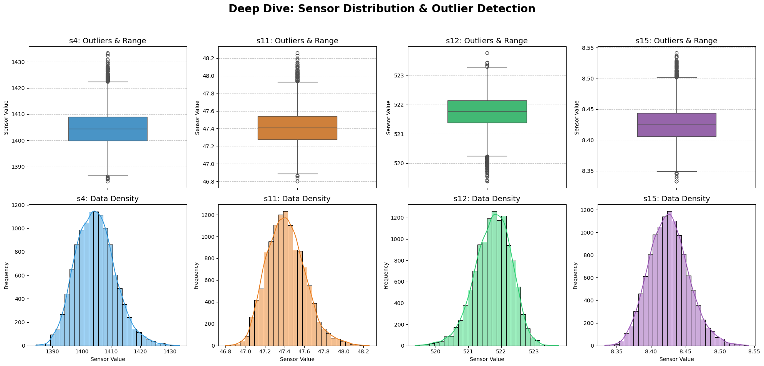
Sensor Spread
Notes:
Outlier Detection (Top Row): The "dots" appearing above the whiskers (especially in s4 and s11) are not random errors; they represent engines in a pre-failure state.
When an engine degrades, its internal temperature and pressure spike beyond normal operating limits, creating these high-side outliers.
Distribution Shape (Bottom Row):
The Right-Skewed histograms show that while most engines operate within a healthy "peak" zone, there is a long "tail" of data points extending to higher values.
The KDE (smooth line) acts as the "source of truth," showing that the transition from a healthy engine to a failing one is marked by a steady drift into these higher-value regions.
Data Density:
The high frequency (tall peaks) shows the "steady-state" operation. The areas where the frequency drops but the sensor values are high represent the "danger zone" where maintenance should have already occurred.

Slide 20
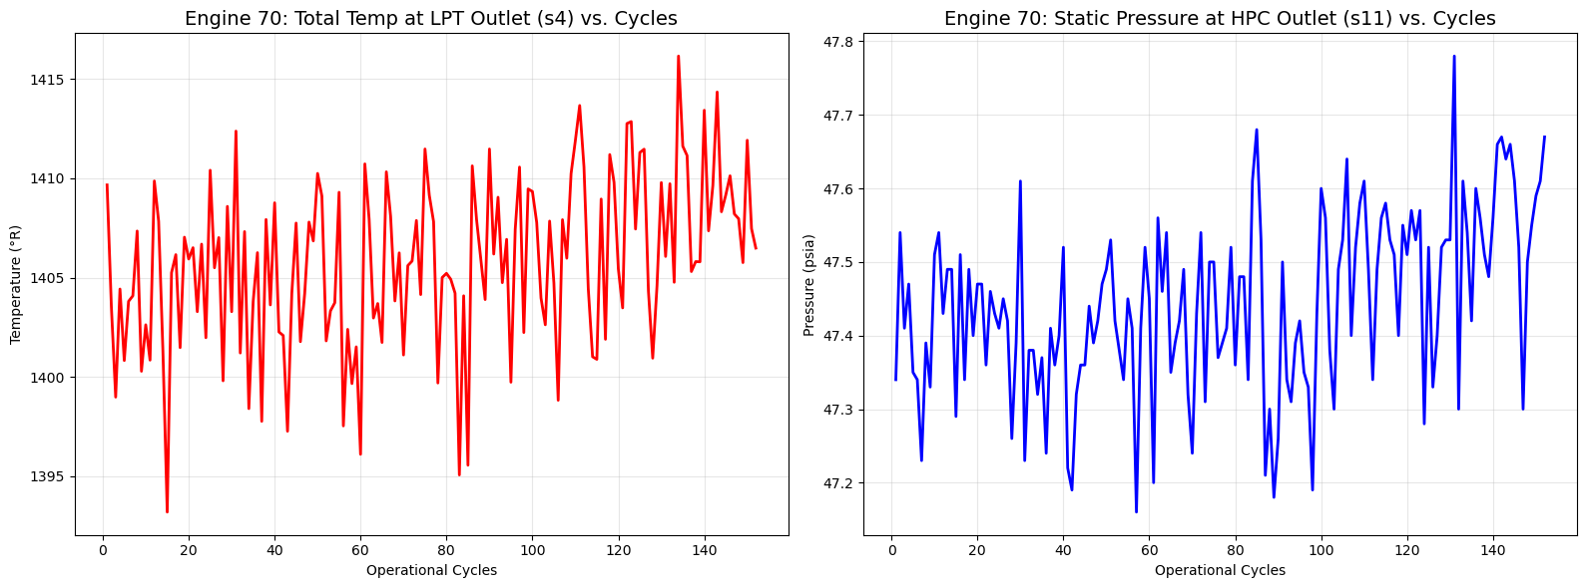
Sensor Trend Over Time
Notes:
In a maintanenance project important relationship is Sensor vs Cycle. If a sensor value increases as the cycle count increases, it is a degradation signal
Plotted 2 continuous numerical variable vs another of the same. Line is stable at the beginning but started to climb steeply at the end of cycle.
From this we can understand that s4 and s11 are direct indicators of wear.

Slide 21
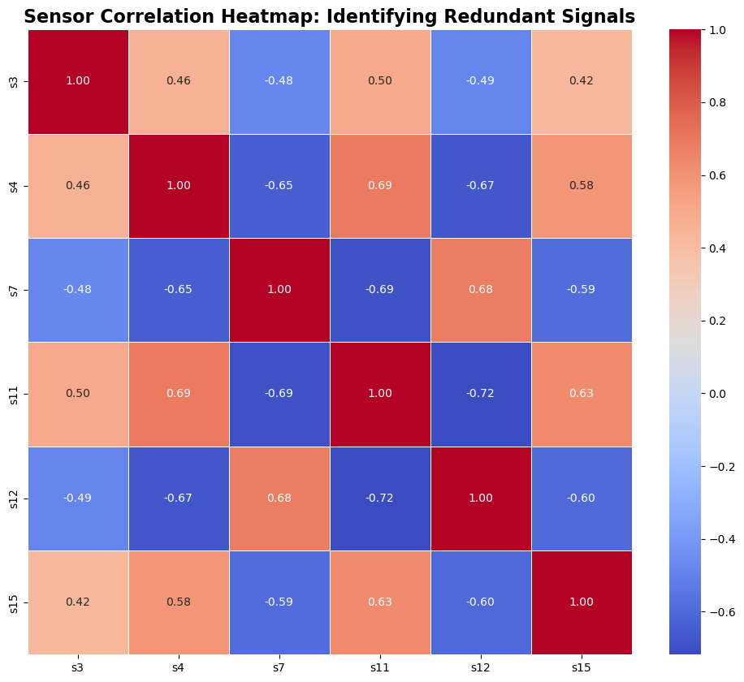
Correlation Analysis
Notes:
Correlation between sensors using heatmap.
1 is perfect match.
S4 and s11 likely have high positive correlation. This means as the engine gets hotter, the internal pressure also spikes.
It shows engine is not falling in one-way, it is a system-wide mechanical collapse involving both the thermal and pneumatic stress

Slide 22
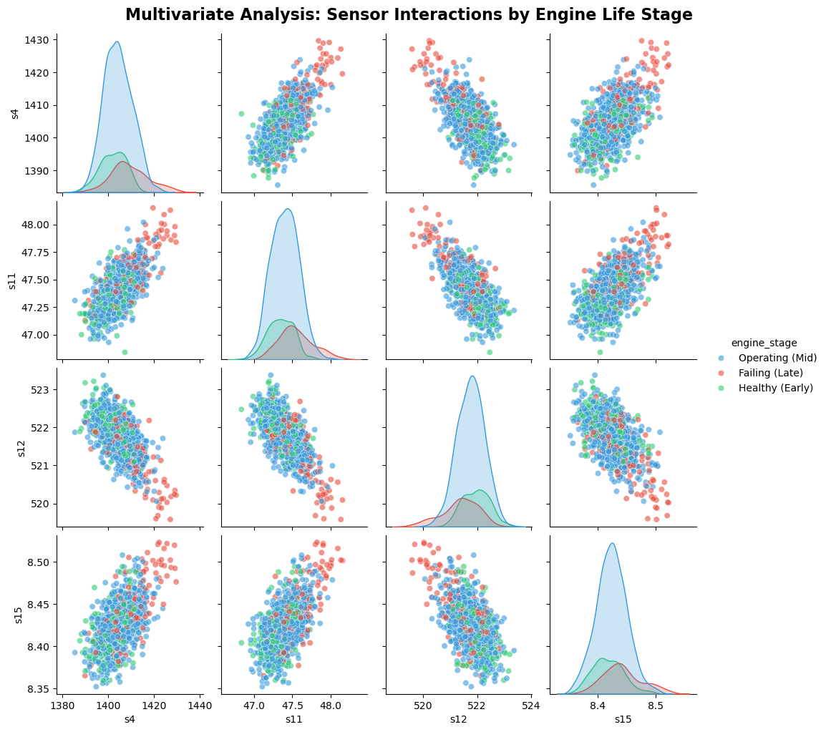
Multivariate Analysis
Notes:
Pairplot- Notice how the Red curve (Failing) is shifted significantly to the right of the Green curve. (Healthy)
The scatter plot- How sensors move together.
Findings: there is a clear separation between colors. The red dots(Late stage) consistently cluster in the higher values across all sensors.
From this plot – sensors are not failing in isolation, there is multivariate signature of failure when temperature s4 and pressure s11 is high, the probalility of failure is 100%.

Slide 23
Conclusion
Temperature and pressure sensors were identified as the most sensitive predictors of engine failure.
By monitoring a specific cluster of sensors(s4,s11,s12,s15) maintenance team can move from a reactive “fix it when it breaks” approach to predictive maintenance.

Slide 24

Thank you

